Slide 1
Chapter 1 Basic Concepts

Slide 2
Outline
Calculating time complexity
Program 1.13: Program 1.11 with count statements
Program 1.15: Program 1.12 with count statements added
Program 1.17: Matrix addition with count statements
Asymptotic Notation
Big-Oh (O)
Big-Omega (Ω)
Big-Theta (Θ)

Slide 3
Program 1.13
回outline
float sum(float list[], int n) {
float tempsum = 0;
count++; //”float tempsum = 0;”
int i;
for(i = 0;i < n;i++){
count++; //”for(i = 0;i < n;i++)”
tempsum += list[i];
count++; //”tempsum += list[i];”
}
count++; //”last execution of for”
count++; //”return tempsum;”
return tempsum;
}

Slide 4
Program 1.13
initial
n = 3, count = 0
float sum(float list[], int n) {
float tempsum = 0;
int i;
for(i = 0;i < n;i++){
tempsum += list[i];
}
return tempsum;
}
count = 1

Slide 5
Program 1.13
initial
n = 3, count = 0
float sum(float list[], int n) {
float tempsum = 0;
int i;
for(i = 0;i < n;i++){
tempsum += list[i];
}
return tempsum;
}
i = 0, count = 2

Slide 6
Program 1.13
initial
n = 3, count = 0
float sum(float list[], int n) {
float tempsum = 0;
int i;
for(i = 0;i < n;i++){
tempsum += list[i];
}
return tempsum;
}
count = 3

Slide 7
Program 1.13
initial
n = 3, count = 0
float sum(float list[], int n) {
float tempsum = 0;
int i;
for(i = 0;i < n;i++){
tempsum += list[i];
}
return tempsum;
}
i = 1, count = 4

Slide 8
Program 1.13
initial
n = 3, count = 0
float sum(float list[], int n) {
float tempsum = 0;
int i;
for(i = 0;i < n;i++){
tempsum += list[i];
}
return tempsum;
}
count = 5

Slide 9
Program 1.13
initial
n = 3, count = 0
float sum(float list[], int n) {
float tempsum = 0;
int i;
for(i = 0;i < n;i++){
tempsum += list[i];
}
return tempsum;
}
i = 2, count = 6

Slide 10
Program 1.13
initial
n = 3, count = 0
float sum(float list[], int n) {
float tempsum = 0;
int i;
for(i = 0;i < n;i++){
tempsum += list[i];
}
return tempsum;
}
count = 7

Slide 11
Program 1.13
initial
n = 3, count = 0
float sum(float list[], int n) {
float tempsum = 0;
int i;
for(i = 0;i < n;i++){
tempsum += list[i];
}
return tempsum;
}
i = 3, count = 8

Slide 12
Program 1.13
initial
n = 3, count = 0
float sum(float list[], int n) {
float tempsum = 0;
int i;
for(i = 0;i < n;i++){
tempsum += list[i];
}
return tempsum;
}
count = 9

Slide 13
Program 1.13
回outline
initial
n = 3, count = 0
float sum(float list[], int n) {
float tempsum = 0;
int i;
for(i = 0;i < n;i++){
tempsum += list[i];
}
return tempsum;
}
1次
n+1次
n次
+
1次
2n+3次

Slide 14
Program 1.15
回outline
float rsum(int list[], int n){
count++; //”if(n)”
if(n){
count++; //”return rsum(list, n-1) + list[n-1];”
return rsum(list, n-1) + list[n-1];
}
count++; //”return list[0];”
return list[0];
}

Slide 15
Program 1.15
initial
n = 3, count = 0
float rsum(int list[], int n){
if(n){
return rsum(list, n-1) + list[n-1];
}
return list[0];
}
n=3, count = 1

Slide 16
Program 1.15
initial
n = 3, count = 0
float rsum(int list[], int n){
if(n){
return rsum(list, n-1) + list[n-1];
}
return list[0];
}
n=3, count = 2

Slide 17
Program 1.15
initial
n = 3, count = 0
float rsum(int list[], int n){
if(n){
return rsum(list, n-1) + list[n-1];
}
return list[0];
}
n=2, count = 3

Slide 18
Program 1.15
initial
n = 3, count = 0
float rsum(int list[], int n){
if(n){
return rsum(list, n-1) + list[n-1];
}
return list[0];
}
n=2, count = 4

Slide 19
Program 1.15
initial
n = 3, count = 0
float rsum(int list[], int n){
if(n){
return rsum(list, n-1) + list[n-1];
}
return list[0];
}
n=1, count = 5

Slide 20
Program 1.15
initial
n = 3, count = 0
float rsum(int list[], int n){
if(n){
return rsum(list, n-1) + list[n-1];
}
return list[0];
}
n=1, count = 6

Slide 21
Program 1.15
initial
n = 3, count = 0
float rsum(int list[], int n){
if(n){
return rsum(list, n-1) + list[n-1];
}
return list[0];
}
n=0, count = 7

Slide 22
Program 1.15
initial
n = 3, count = 0
float rsum(int list[], int n){
if(n){
return rsum(list, n-1) + list[n-1];
}
return list[0];
}
n=0, count = 8

Slide 23
Program 1.15
回outline
initial
n = 3, count = 0
float rsum(int list[], int n){
if(n){
return rsum(list, n-1) + list[n-1];
}
return list[0];
}
n+1次
n次
+
1次
2n+2次

Slide 24
Program 1.17
回outline
void add(int a[][MAX_SIZE], b[][MAX_SIZE],
c[][MAX_SIZE], int rows, int cols) {
int i, j;
for(i = 0;i < rows; i++){
count++; //” for(i = 0;i < rows; i++)”
for(j = 0;j < cols; j++){
count++; //” for(j = 0;j < cols; j++)”
c[i][j] = a[i][j] + b[i][j];
count++; //”c[i][j] = a[i][j] + b[i][j] = 0;j < cols; j++)”
}
count++; //"last time of j for loop”
}
count++; //"last time of i for loop”
}

Slide 25
Program 1.17
initial
rows=2, cols=3, count = 0
void add(int a[][MAX_SIZE], b[][MAX_SIZE],
c[][MAX_SIZE], int rows, int cols) {
int i, j;
for(i = 0;i < rows; i++){
for(j = 0;j < cols; j++){
c[i][j] = a[i][j] + b[i][j];
}
}
}
i = 0, count = 1

Slide 26
Program 1.17
initial
rows=2, cols=3, count = 0
void add(int a[][MAX_SIZE], b[][MAX_SIZE],
c[][MAX_SIZE], int rows, int cols) {
int i, j;
for(i = 0;i < rows; i++){
for(j = 0;j < cols; j++){
c[i][j] = a[i][j] + b[i][j];
}
}
}
j = 0, count = 2

Slide 27
Program 1.17
initial
rows=2, cols=3, count = 0
void add(int a[][MAX_SIZE], b[][MAX_SIZE],
c[][MAX_SIZE], int rows, int cols) {
int i, j;
for(i = 0;i < rows; i++){
for(j = 0;j < cols; j++){
c[i][j] = a[i][j] + b[i][j];
}
}
}
count = 3

Slide 28
Program 1.17
initial
rows=2, cols=3, count = 0
void add(int a[][MAX_SIZE], b[][MAX_SIZE],
c[][MAX_SIZE], int rows, int cols) {
int i, j;
for(i = 0;i < rows; i++){
for(j = 0;j < cols; j++){
c[i][j] = a[i][j] + b[i][j];
}
}
}
j = 1, count = 4

Slide 29
Program 1.17
initial
rows=2, cols=3, count = 0
void add(int a[][MAX_SIZE], b[][MAX_SIZE],
c[][MAX_SIZE], int rows, int cols) {
int i, j;
for(i = 0;i < rows; i++){
for(j = 0;j < cols; j++){
c[i][j] = a[i][j] + b[i][j];
}
}
}
count = 5

Slide 30
Program 1.17
initial
rows=2, cols=3, count = 0
void add(int a[][MAX_SIZE], b[][MAX_SIZE],
c[][MAX_SIZE], int rows, int cols) {
int i, j;
for(i = 0;i < rows; i++){
for(j = 0;j < cols; j++){
c[i][j] = a[i][j] + b[i][j];
}
}
}
j = 2, count = 6

Slide 31
Program 1.17
initial
rows=2, cols=3, count = 0
void add(int a[][MAX_SIZE], b[][MAX_SIZE],
c[][MAX_SIZE], int rows, int cols) {
int i, j;
for(i = 0;i < rows; i++){
for(j = 0;j < cols; j++){
c[i][j] = a[i][j] + b[i][j];
}
}
}
count = 7

Slide 32
Program 1.17
initial
rows=2, cols=3, count = 0
void add(int a[][MAX_SIZE], b[][MAX_SIZE],
c[][MAX_SIZE], int rows, int cols) {
int i, j;
for(i = 0;i < rows; i++){
for(j = 0;j < cols; j++){
c[i][j] = a[i][j] + b[i][j];
}
}
}
j = 3, count = 8

Slide 33
Program 1.17
initial
rows=2, cols=3, count = 0
void add(int a[][MAX_SIZE], b[][MAX_SIZE],
c[][MAX_SIZE], int rows, int cols) {
int i, j;
for(i = 0;i < rows; i++){
for(j = 0;j < cols; j++){
c[i][j] = a[i][j] + b[i][j];
}
}
}
i = 1, count = 9

Slide 34
Program 1.17
initial
rows=2, cols=3, count = 0
void add(int a[][MAX_SIZE], b[][MAX_SIZE],
c[][MAX_SIZE], int rows, int cols) {
int i, j;
for(i = 0;i < rows; i++){
for(j = 0;j < cols; j++){
c[i][j] = a[i][j] + b[i][j];
}
}
}
j = 0, count = 10

Slide 35
Program 1.17
initial
rows=2, cols=3, count = 0
void add(int a[][MAX_SIZE], b[][MAX_SIZE],
c[][MAX_SIZE], int rows, int cols) {
int i, j;
for(i = 0;i < rows; i++){
for(j = 0;j < cols; j++){
c[i][j] = a[i][j] + b[i][j];
}
}
}
count = 11

Slide 36
Program 1.17
initial
rows=2, cols=3, count = 0
void add(int a[][MAX_SIZE], b[][MAX_SIZE],
c[][MAX_SIZE], int rows, int cols) {
int i, j;
for(i = 0;i < rows; i++){
for(j = 0;j < cols; j++){
c[i][j] = a[i][j] + b[i][j];
}
}
}
j = 1, count = 12

Slide 37
Program 1.17
initial
rows=2, cols=3, count = 0
void add(int a[][MAX_SIZE], b[][MAX_SIZE],
c[][MAX_SIZE], int rows, int cols) {
int i, j;
for(i = 0;i < rows; i++){
for(j = 0;j < cols; j++){
c[i][j] = a[i][j] + b[i][j];
}
}
}
count = 13

Slide 38
Program 1.17
initial
rows=2, cols=3, count = 0
void add(int a[][MAX_SIZE], b[][MAX_SIZE],
c[][MAX_SIZE], int rows, int cols) {
int i, j;
for(i = 0;i < rows; i++){
for(j = 0;j < cols; j++){
c[i][j] = a[i][j] + b[i][j];
}
}
}
j = 2, count = 14

Slide 39
Program 1.17
initial
rows=2, cols=3, count = 0
void add(int a[][MAX_SIZE], b[][MAX_SIZE],
c[][MAX_SIZE], int rows, int cols) {
int i, j;
for(i = 0;i < rows; i++){
for(j = 0;j < cols; j++){
c[i][j] = a[i][j] + b[i][j];
}
}
}
count = 15

Slide 40
Program 1.17
initial
rows=2, cols=3, count = 0
void add(int a[][MAX_SIZE], b[][MAX_SIZE],
c[][MAX_SIZE], int rows, int cols) {
int i, j;
for(i = 0;i < rows; i++){
for(j = 0;j < cols; j++){
c[i][j] = a[i][j] + b[i][j];
}
}
}
j = 3, count = 16

Slide 41
Program 1.17
initial
rows=2, cols=3, count = 0
void add(int a[][MAX_SIZE], b[][MAX_SIZE],
c[][MAX_SIZE], int rows, int cols) {
int i, j;
for(i = 0;i < rows; i++){
for(j = 0;j < cols; j++){
c[i][j] = a[i][j] + b[i][j];
}
}
}
i = 2, count = 17

Slide 42
Program 1.17
回outline
initial
rows=2, cols=3, count = 0
void add(int a[][MAX_SIZE], b[][MAX_SIZE],
c[][MAX_SIZE], int rows, int cols) {
int i, j;
for(i = 0;i < rows; i++){
for(j = 0;j < cols; j++){
c[i][j] = a[i][j] + b[i][j];
}
}
}
rows+1 次
rows*(cols+1) 次
+
rows*cols 次
2rows*cols+2rows+1 次

Slide 43
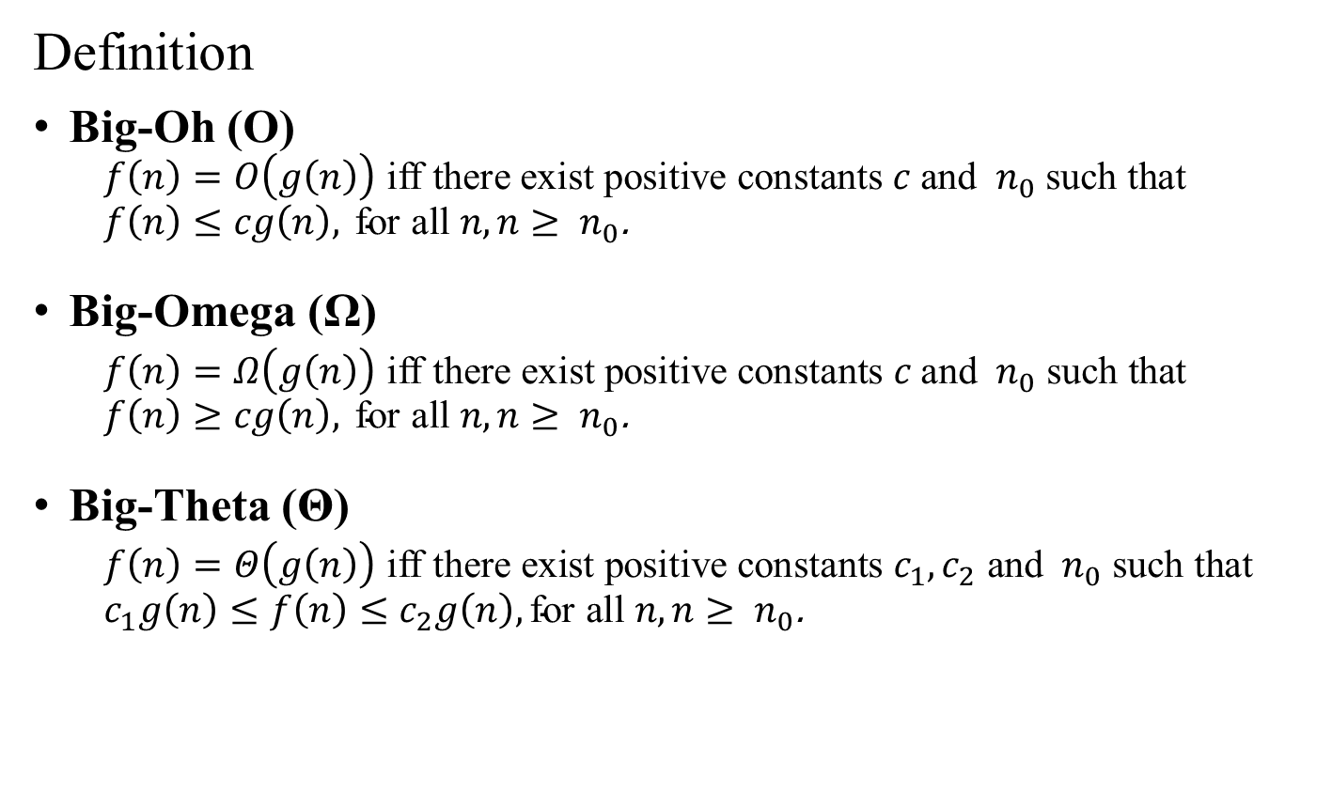
Asymptotic Notation
Definition
Big-Oh (O)
$$f\left(n\right)=O\left(g\left(n\right)\right) \text{iff} \text{there} \text{exist} \text{positive} \text{constants} c \text{and} { n}_{0} \text{such} \text{that}$$
$$f\left(n\right)≤cg\left(n\right), \text{for} \text{all} n, n≥{ n}_{0}\text{.}$$
Big-Omega (Ω)
$$f\left(n\right)=Ω\left(g\left(n\right)\right) \text{iff} \text{there} \text{exist} \text{positive} \text{constants} c \text{and} { n}_{0} \text{such} \text{that}$$
$$f\left(n\right)≥cg\left(n\right), \text{for} \text{all} n, n≥{ n}_{0}\text{.}$$
Big-Theta (Θ)
$$f\left(n\right)=Θ\left(g\left(n\right)\right) \text{iff} \text{there} \text{exist} \text{positive} \text{constants} c_{1},c_{2} \text{and} { n}_{0} \text{such} \text{that}$$
$$c_{1}g\left(n\right)≤f\left(n\right)≤c_{2}g\left(n\right), \text{for} \text{all} n, n≥{ n}_{0}\text{.}$$
Notes:
若且唯若（英語：if and only if，iff）
存在: $∃$
對於所有: $∀$

Slide 44


Asymptotic Notation (O)
Definition
$f\left(n\right)=O\left(g\left(n\right)\right)$ iff there exist positive constants $c$ and ${ n}_{0}$ such that
$f\left(n\right)≤cg\left(n\right),$ for all $n, n≥{ n}_{0}$.
Examples
$3n+2=O(n)$
$3n+3=O(n)$
$100n+6=O(n)$
$10n^{2}+4n+2=O(n^{2})$
$6∗2^{n}+n^{2}=O(2^{n})$
$3n+2≤4n$ for $n≥2$
$3n+3≤4n$ for $n≥3$
$100n+6≤101n$ for $n≥6$
$10n^{2}+4n+2≤11n^{2}$ for $n≥5$
$6∗2^{n}+n^{2}≤7∗2^{n}$ for $n≥4$
Notes:
若且唯若（英語：if and only if，iff）
存在: $∃$
對於所有: $∀$

Slide 45


Asymptotic Notation (Ω)
Definition
$f\left(n\right)=Ω\left(g\left(n\right)\right)$ iff there exist positive constants $c$ and ${ n}_{0}$ such that
$f\left(n\right)≥cg\left(n\right),$ for all $n, n≥{ n}_{0}$.
Examples
$3n+2=Ω(n)$
$3n+3=Ω(n)$
$100n+6=Ω(n)$
$10n^{2}+4n+2=Ω(n^{2})$
$6∗2^{n}+n^{2}=Ω(2^{n})$
$3n+2≥3n$ for $n≥1$
$3n+3≥3n$ for $n≥1$
$100n+6≥100n$ for $n≥1$
$10n^{2}+4n+2≥10n^{2}$ for $n≥1$
$6∗2^{n}+n^{2}≥6∗2^{n}$ for $n≥1$
Notes:
若且唯若（英語：if and only if，iff）
存在: $∃$
對於所有: $∀$

Slide 46
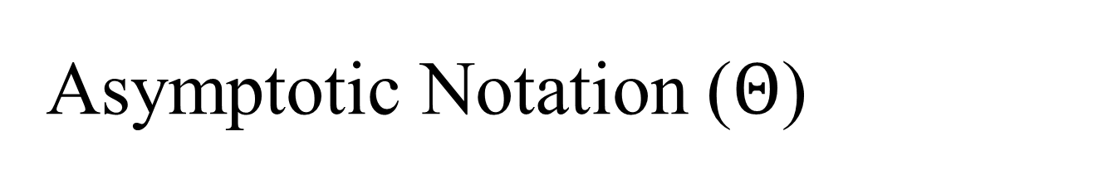
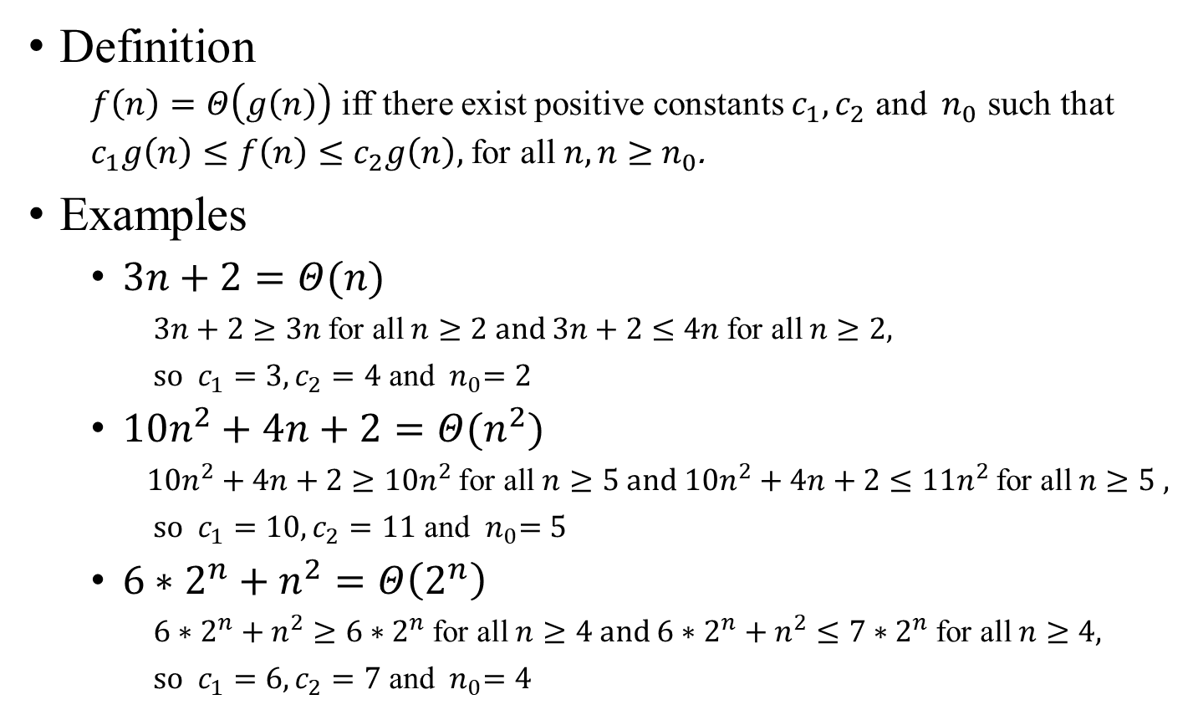
Asymptotic Notation ($Θ$)
Definition
$f\left(n\right)=Θ\left(g\left(n\right)\right)$ iff there exist positive constants $c_{1},c_{2}$ and ${ n}_{0}$ such that
$c_{1}g\left(n\right)≤f\left(n\right)≤c_{2}g\left(n\right),$for all $n, n≥{ n}_{0}$.
Examples
$3n+2=Θ(n)$
$3n+2≥3n$ for all $n≥2$ and $3n+2≤4n$ for all $n≥2$,
so $c_{1}=3,c_{2}=4$ and ${ n}_{0}=2$
$10n^{2}+4n+2=Θ(n^{2})$
$10n^{2}+4n+2≥10n^{2}$ for all $n≥5$ and $10n^{2}+4n+2≤11n^{2}$ for all $n≥5$ ,
so $c_{1}=10,c_{2}=11$ and ${ n}_{0}=5$
$6∗2^{n}+n^{2}=Θ\left(2^{n}\right)$
$6∗2^{n}+n^{2}≥6∗2^{n}$ for all $n≥4$ and $6∗2^{n}+n^{2}≤7∗2^{n}$ for all $n≥4$,
so $c_{1}=6,c_{2}=7$ and ${ n}_{0}=4$
Notes:
若且唯若（英語：if and only if，iff）
存在: $∃$
對於所有: $∀$

